Slide 1

2026 Education Calendar
For Financial professional / TPA / plan sponsor use only. Not for use with participants. Not for public distribution.
Products and services offered through the Voya® family of companies.
5005450_1025 CN4932064_1027
Notes:
Today we’ll discuss our 2026 education calendar and how we’ll deliver a more integrated, personalized experience that helps people feel more confident in their financial decisions. You’ll see how our channels come together with our website, webinars, and personalized emails, to create one consistent experience across channels.

Slide 2


How consumers feel going into 2026:
Nearly
80%
of workers report that credit card debt is a major/minor problem¹
Over
60%
of Americans believe that inflation will have a severe or major impact on their ability to save for retirement²
Nearly
60%
of Americans report that ways to improve their overall financial wellness would make them more likely to stay with their current employer³
1 EBRI 2025 Workplace Wellness Survey.
2 Voya Financial Consumer Insights & Research survey conducted Aug 5–6, 2025, among 1,005 adults aged 18+ in the U.S., featuring 496 Americans working full-time or part-time.
3 Voya Financial Consumer Insights & Research survey conducted Apr 28–29, 2025, among 1,002 adults aged 18+ in the U.S., featuring 491 Americans working full-time or part-time.
Notes:
These insights demonstrate the need for education and support, and our education calendar is designed to address these concerns.

Slide 3






2026
Education Goals
Holistic experience
Evolved experience
Test and learn
Participants and employees feel education is integrated across channels.
Improved and more engaging user experience on voya.com with a new library and Voya Learn live webinar platform.
Pilot and learn across education channels and use insights to continuously improve the participant experience.
Notes:
Our goal is to improve the overall employee and participant educational experience. With that, we have some exciting changes coming in 2026.
Holistic experience: Employees and participants will feel a connected educational experience across channels, Whether they are on our voya.com website, attending a Voya Learn live session, receiving a personalized education email or reviewing the Financial Wellness calendar, topics and education will be aligned so it’s a cohesive and connected experience.
Evolved experience: We are enhancing Voya.com with a new education library that brings together all our education into one, consolidated library to make education easier to find, no matter what type of medium the education is (e.g. article, on-demand videos, calculators, etc.). We are also improving our Voya Learn live webinar platform, so it provides more of an educational journey to help attendees learn more on the topic that they are interested in.
Test and learn: We’re committed to a “pilot and learn” approach. That means we’ll continuously test new ideas across our education channels, gather insights, and use what we learn to improve the participant experience. This cycle of innovation ensures we’re always moving forward and adapting to what participants and employees need.

Slide 4



2026 Engagement and education overview
 | Q1 | Q2 | Q3 | Q4
Quarterly education | Supported through emails and content hubs.
Financial Wellness Financial professional Budgeting
Financial stress College planning Emergency savings
Mid-year check-in Budget check-in Retirement income planning
Cybersecurity Retirement readiness COLA limits
Participant web messages (account login)
Always on Voya.com digital resources 24/7
Voya.com resources
  Education library with articles, live and on-demand learning, calculators and more
  Market Volatility resource center
  Life stage guidance
  IRS limits microsite
Roth microsite
Voya Cares®
Beneficiaries
Saving more
Preparing for taxes
Retirement savings check-in
Caregiving and benefits
Family milestones planning
Review protection needs
Always on participant website digital resources 24/7
Estate planning
Year-end planning
Participant web experience
myOrangeMoney® experience
Financial Wellness Experience
Voya mobile app
Account aggregation
Budgeting tool
Personalized journeys
(emails to be sent to eDelivery/users *text available)
Diversify
Birthday
Advice
Max out
Beneficiary*
Restart*
Save More*
Health Savings Account¹
401(k)/
403(b) Day
*Text messaging also available.
1 Must have a Voya retirement and Health Savings Account.
Notes:
This provides a holistic overview of the education we provide to participants throughout the year.
Quarterly education: This provides an overview of the educational topics that we’ll be focusing on each quarter throughout the year. These topics are highlighted in our Financial Wellness calendar, on voya.com and in our personalized education emails.
Participant web messages: These messages are always-on, dynamic education to nudge participants to their next best action.
Personalized journeys: Through data modeling and intelligent automation, we deliver personalized email messages to nudge participants towards their next best action. Whether that is to save more, diversify investments, designate a beneficiary, or consume education to help achieve financial wellness, we help participants stay focused to reach desired outcomes. The journeys are scored against each other so that employees receive the next best step tailored to them.
Always on Voya.com digital resources: These are resources on voya.com that employees and participants can access that provides education on all topics related to preparing for retirement, protection, personal finances and more. They will have the opportunity to read articles, sign up for live webinars, watch on-demand videos, use calculators to model scenarios and more.
Always on participant website digital resources: Participants will have access to our participant web experience, where they will be able to aggregate their all their accounts to see their full financial picture, enroll in life event journeys, get insights on their spending habits, view and update their budget, use myOrangeMoney to estimate their retirement savings, model scenarios, increase contributions, assess their Financial Wellness and get education based on their needs, and more.
We also provide education resources for national campaigns such as America Saves Week, National 401(k) or 403(b) Day and National Retirement Security Month.

Slide 5
Holistic educational experience
A unified education experience, centered on the Financial Wellness Calendar:
Aligned topics across channels: email, live webinars, and education library
Personalized touchpoints: timely content that meets participants where they are
Consistent experience: one message and theme across many channels, aiming to drive clarity and confidence
Financial Wellness Calendar
Voya.com educational library
Personalized education emails
Voya Learn live webinars
Notes:
Our education experience will be centered around our 2026 Financial Wellness calendar. Whether an employee is on our website, reviewing our Voya Learn live webinar, or receiving personalized educational emails, employees will see similar messaging and themes across many channels, hopefully driving clarity and confidence with employees and participants.

Slide 6
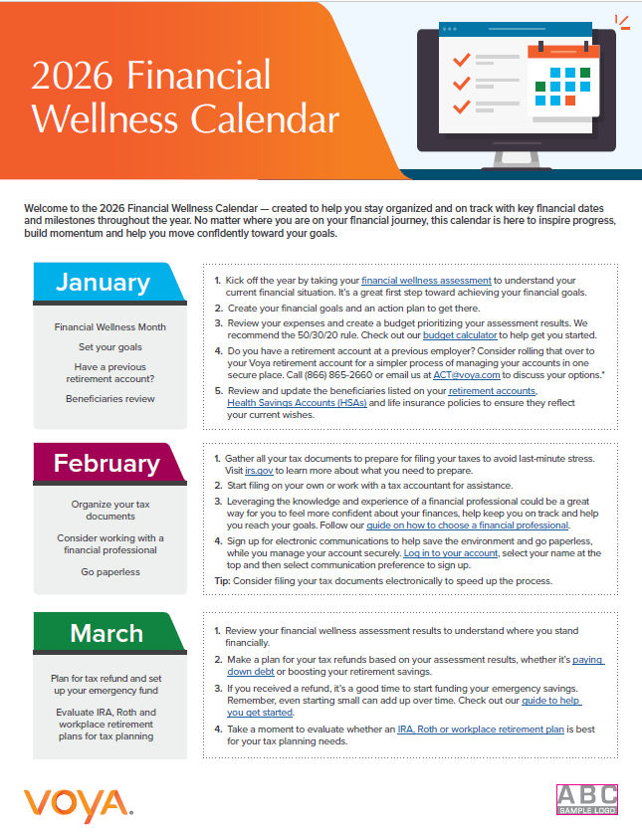
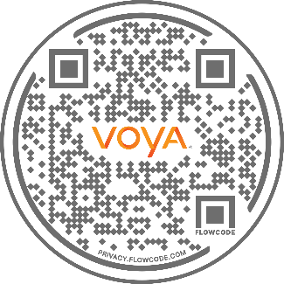
2026 Financial Wellness Calendar
The 2026 Financial Wellness Calendar is a practical, month-by-month roadmap designed to help individuals stay organized and proactive about their financial wellness. Each month features timely reminders, actionable tips, and educational resources covering topics like budgeting, retirement planning, employee benefits, and key deadlines. Encourage employees to follow the monthly prompts and use the calendar as a resource to help build financial confidence all year long.
Scan QR code to visit Voya.com to print or download the calendar.
Notes:
Our Financial Wellness calendar is a practical monthly roadmap with reminders, tips, and resources for budgeting, benefits, retirement planning, and deadlines. Our goal is to provide education throughout the year, to employees and participants, to improve their financial literacy while also providing nudges and building confidence throughout the year.

Slide 7
2026 Financial Wellness education topics
Q1
Start strong
Q2
Build momentum
Q3
Mid-year check-in
Q4
Prepare for the future
Assess financial wellness
Set financial goals
Prepare for tax season
Working with a financial professional
Create or review budgets
Review and update beneficiaries
America Saves Week
Financial Literacy Month
Financial stress on mental health
College planning
Caregiving and benefits
Retirement savings check-in
Budget check-in
Retirement income planning
Plan for family milestones
Back to school planning
Review protection needs
Holiday planning
National 401(k)/403(b) Day
National Retirement Security Month
HSA Day
Protecting accounts with cybersecurity
Evaluate retirement readiness
Estate planning
Year-end planning
Trending topics
Notes:
This dives a little deeper into the topics covered in the Financial Wellness calendar. Let’s look at the topics we’ll highlight each quarter. We will also offer education around any trending topics throughout the year such as market volatility, COLA limits and more.
<Review topics within each of the quarters.>

Slide 8
Personalized education newsletters
Month | Topics
January | 2026 Financial Wellness Calendar 30 Minute money reset Live webinar – Financial Wellness
March | Save more/America Saves Week (April) Live webinar – Spending and saving
May | How financial debt can affect your mental well-being—and strategies to manage the stress Live webinar - Retirement planning under/over 40
July | Midyear Retirement Check: Are You on Track? Live webinar – 6 steps for a mid-year check-in
September | National Retirement Security Month (Oct.) Live webinar – Healthcare in retirement
December | Design your 2027 savings plan Live webinar: Year-end finances
Evolving Participant Education in 2026
We’re moving from one‑off education emails to an integrated, outcomes‑focused program. In 2026 we’ll expand A/B testing and continuous learning to refine content and improve targeted messaging, while aligning emails with other education channels. The result: a unified, holistic experience where participants receive the right messages at the right time.
Notes:
In 2026, we’ll expand A/B testing to have a more targeted and personalized educational email, aligning email content and timing with webinars and library topics for one unified experience. You’ll see the topics that we will be focusing on in each personalized education email, along with the Voya Learn live webinar that we will highlighting within each of the emails.

Slide 9
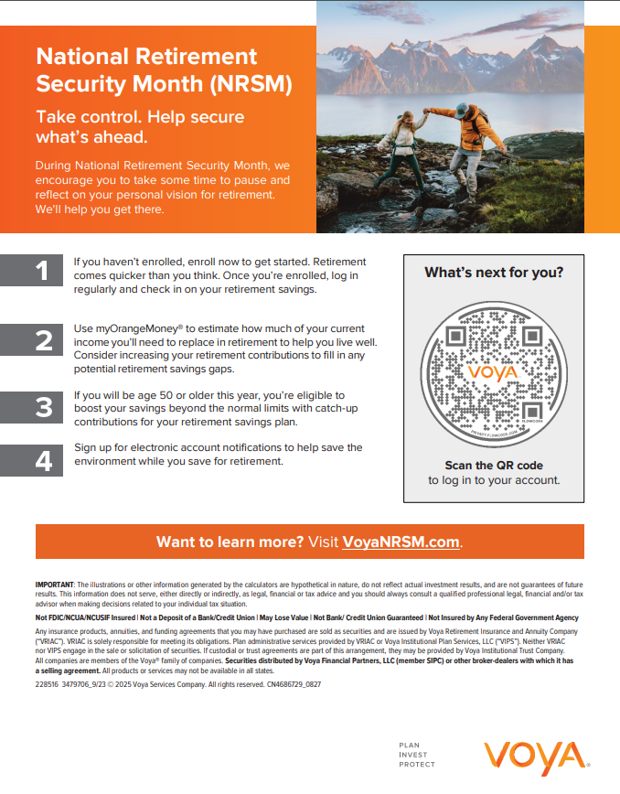
National Education Campaigns
America Saves Week
National Retirement Security Month
National 401(k)/403(b) Day
Materials within the campaigns:
Flyer (Eng. & Span.)
Digital Signage
Included in personalized email newsletter
Notes:
Our upcoming National Education Campaigns will feature a suite of marketing materials designed to drive participant engagement and promote account activity. These include:
Flyers for onsite or virtual distribution
Digital signage for high-visibility placement
Personalized email newsletters with targeted callouts
Each campaign is strategically crafted to encourage participants to explore educational resources and take action, specifically to log into their accounts and engage with tools that support their financial wellness. As a plan sponsor, you’ll have access to these materials in advance to support your communication efforts and reinforce campaign messaging.

